Slide 1
Best Practice In-Service Day 2/12/16
sharon Beyer otr/l
Kim Hartranft otd, otr/l
Carol mulligan pt

Slide 2
Occupational and Physical Therapy according to IDEA
Defined as a related service
Supportive service that is required to assist a child with a disability to benefit from special education
OT/PT may be delivered for students who do not receive special education but have a medical condition under Section 504 of the Rehabilitation Act

Slide 3
IDEA is promoting “Integrated Model”
* IDEA is pushing more towards an integrated model for delivery of service.
* Experts indicate that goals and objectives belong to the student and all team members are responsible for contributing information and skills for maximum success of the student.
* It is important to realize that the only way our services can be effective if the educational team and families follow through on strategies offered on a daily and consistent basis.

Slide 4
Gross Motor Development and Postural Strategies for the Classroom
Carol mulligan
cmulligan@wsdweb.org
2/12/16

Slide 5
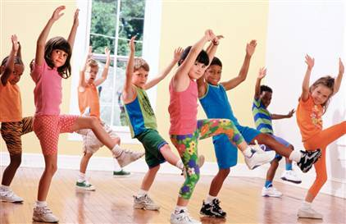
Physical Therapy
-Functional Mobility
-Gross Motor Skills
-includes Locomotor and Object Manipulation
-Strengthening
-Seating/Positioning
-Coordination
-Motor Planning/Body in space
-Balance
-Flexibility
-Endurance
- Speed

Slide 6
Common Gross Motor Milestones Pre-school Age (3-4 years)
Throws ball forward 10 feet
Walks on a line 10 feet
Hops 2-10 times on 1 foot
Jumps forward distances of up to 2 feet
Jumps over obstacles up to 12 inches off the ground
Throws and catches a small ball
Runs and avoids obstacles
Walks up and down stairs alternating feet
Gallops

Slide 7
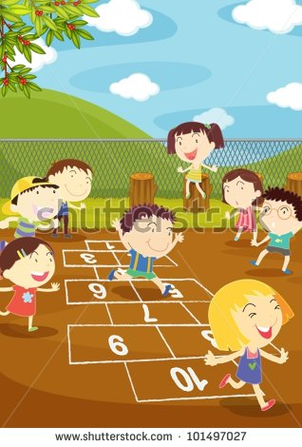
Common Gross Motor Milestones Early School Age (5-8 years)
Skips on alternate feet
Hopscotch
Balances on 1 foot up to 10 seconds
Jumps with rhythm and control (jump rope)
Bounces large ball
Kicks ball with improved directional control
Runs with coordination

Slide 8
Common Gross Motor Milestones Later School Age (9-12 Years)
Mature patterns of movement for throwing, jumping, and running
Improved balance, coordination, endurance, and attention span

Slide 9
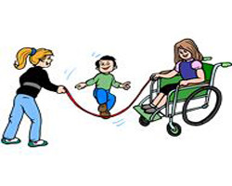
Strategies to promote Gross Motor Development needed for Primary Grades
Challenging GMS Strategy
Switching feet on the stairs Walk next to student modeling and practice
Standing on one foot Practice with class during movement breaks
Jumping and hopping Use hopscotch when doing math or break times
Walking on toes Prompts to walk “heel toe”
Motor Planning/Strength Play on the playground equipment

Slide 10
Trunk Control
Need a strong and stable trunk
1)Normalize tone or decrease abnormal influence on the body.
2) Maintain skeletal alignment.
3) Prevent, accommodate or correct skeletal deformity.
4) Provide stable base of support to promote function.
5) Promote increased tolerance of desired position
6) Promote comfort and relaxation.
7) Facilitate normal movement patterns or control abnormal movement patterns.
8) Manage pressure or prevent the development of pressure sores.
9) Decrease fatigue
10) Enhance autonomic nervous system function (cardiac, digestive and respiratory
function)
11) Facilitate maximum function with minimum pathology.

Slide 11
***Signs that a child may lack trunk control include:
-leaning on table, propping on hands, fatigue during sustained tasks, falling out of their chair; frequent changes of position; getting in and out of their seat beyond what is allowed; slumping over their desk; wrapping their legs around the legs of the chair; or propping themselves on other surfaces such as the desk or holding their head on their hand.
-These are indicators that there may be issues with strength, muscle tone, fatigue, vision or other problems.

Slide 12
What is the best position?
Traditional emphasis regarding positioning is placed on achieving an upright symmetrical posture utilizing the 90-90-90 flexion at the hips, knees and ankles position
When considering posture, one should not consider it as static, but as an active and dynamic process which underpins movement and function. Normally, our postures continuously shift and change position to facilitate movement to engage in functional activities.
Seating solutions may require reaching a balance between an upright anatomical symmetrical posture and ability to function
For functional movement to occur in sitting, literature suggests that stability of proximal body parts (pelvis, spine and shoulders) is a prerequisite for distal control

Slide 13
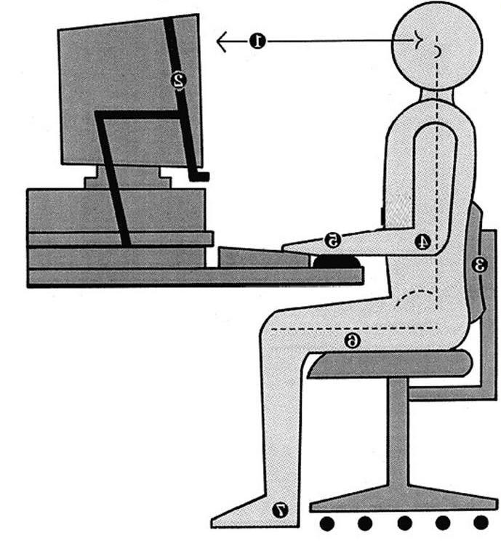
90-90-90 Rule

Slide 14
Positioning is Important in an Academic Setting
Positioning, seating and mobility play a critical role in a student's ability to function in the academic setting.
Use the 90 - 90 - 90 rule. Ankles, hips, and knees should be bent to a 90-degree angle for appropriate sitting posture.
Look at correct sitting posture and appropriate chair and table heights. A child’s feet should be flat on the floor and the desktop should be 2 inches above the bent elbow or right above the navel/belly button. If table is too high, elbows will be up and out to sides. If table is too low, the child will slump in their chair or rest their head on their hand.
Use footstool to support feet if the child's feet do not rest flat on the floor. Allow students to work in various positions other than seated (standing at a vertical surface, lying on the floor propped on elbows).

Slide 15
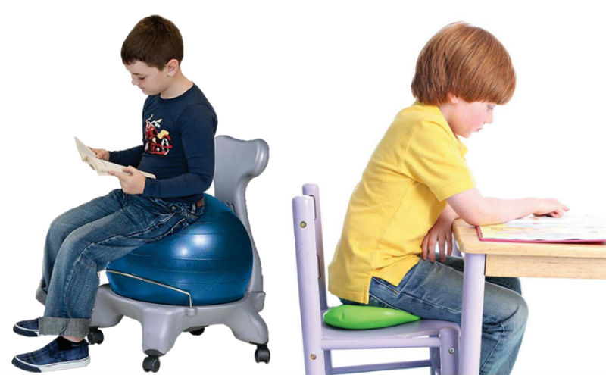
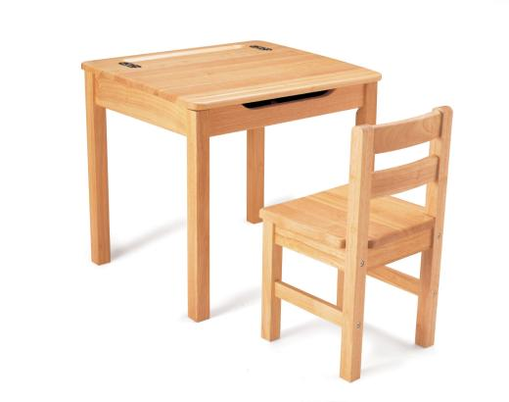
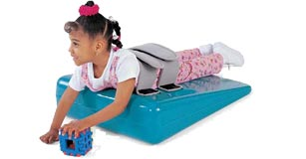
Strategies for Positioning
Place block/stool under feet if feet cannot be on the floor.
Allow child to rest forearms on desk during writing, cutting and drawing.
Cushions or wedges
A slant-board or 3” binder.
Alternative positions: standing, kneeling, or lying on the belly.

Slide 16
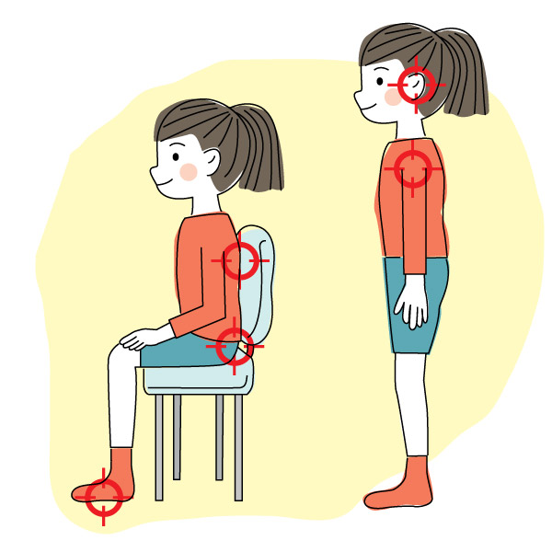
Stable Core is important for FMS and GMS
Movement skills develop from closest to the body to further out/proximal to distal. In order to move your fingers or toes separately in a controlled way, parts closer to the center of the body must be stable-trunk, pelvis, shoulder, and hip. This stability comes from both the muscles of the body and how the body is supported.
Posture is a foundational skill for developing fine motor skills
and learning to write.
Poor sitting posture can restrict breathing, cause back pain
and limit development of FMS.

Slide 17
Fine Motor Strategies for the Classroom
Sharon C. Beyer OTR/L
Sbeyer@wsdweb.org
2/12/16

Slide 18
Occupational Therapy
-Neuromuscular Skills
-Fine Motor Skills
-Functional Handwriting
-Visual Perceptual Skills
-School related Self Help Skills
-Sensory Processing Skills

Slide 19
Fine Motor Developmental Milestones 3-4 years
Places pegs in holes
Completes simple puzzles with 5-8 pieces
Manipulates clay by making balls, snakes, etc
Builds a tower of 9 blocks
Strings small and medium size beads
Builds with construction toys-blocks, duplos
Cuts on a straight line with scissors
Fisted, palmar or five finger grasp on a marker

Slide 20
Fine Motor Developmental Milestones 4-5 years
Completes puzzles with 12-18 pieces
Firmly established hand dominance (4-6 years)
Five finger grasp (4years)
Tripod grasp (5 years)
Copies a cross, circle and square
Cuts on a curved line
Cuts around large simple shapes

Slide 21
Fine Motor Developmental Milestones 5-6 years
Completes puzzles with 18-35 pieces
Colors within the lines
Tripod grasp on a marker or crayon
Copies square, triangle, diagonal lines
Cuts around shapes with corners and curves using helping hand to hold and turn paper

Slide 22
Postural Stability
*Need a strong and stable trunk to maintain an upright posture for writing.
*Signs that a child may lack trunk control include leaning on table, propping on hands, fatigue during sustained tasks.
*Strategies: Appropriate chair and desk height. Feet on floor.

Slide 23
Posture Strategies
*Place block under feet.
*Allow child to rest forearms on desk during writing, cutting and drawing.
* Cushions or wedges
*A slant-board or 3” binder.
*Alternative positions: standing, kneeling, or lying on the belly.

Slide 24
Bilateral Coordination
* Coordination between the right and left side of the body.
* In the area of fine motor skills, it is generally the ability to use the right and left or working and helping hand together.
* Need to have a clearly established hand dominance.
Developing hand dominance should begin around age three
Hand dominance for tool use should be firmly established by age five and one half years.

Slide 25
Shoulder Stability
*Muscles work together to hold this joint stable when writing.
*Problems with handwriting can stem from poor posture or shoulder positioning.
*Strategies
Write on a vertical surface
Encourage games in quadruped.
Lie on belly and write on a clipboard.

Slide 26
Wrist Stability in Extension
* Children with fine motor delays often compensate for inadequate stabilization of the wrist by flexing the wrist (bending it forward so the palm gets closer to the forearm).
*The ideal position of the wrist is a slightly extended position which allows for better thumb positioning , palmar arching and isolation of finger movements.
* Strength and Endurance—note position in the morning vs. afternoon.

Slide 27
Wrist Extension Strategies
*Work on an elevated surface such as a slant board or on a vertical surface.
* Leaning on one hand on floor while working on an activity such as a puzzle or large picture.
* Activities that involve weight bearing on the hand, such as wheel barrow, crab, bear walking.

Slide 28
Palmar Arches
* There are longitudinal, diagonal and oblique arches of the hand.
* The arches in the hands shape the hand to grasp different size objects, direct skilled movements of the fingers, and grade the power of grasps.
* The skilled movements of the hands work off of these arches.
* Some palmar arch development is present at birth but most of it develops in the first few years.
* Weight bearing on our palms (crawling and scooting) strengthen the muscles that pull the pinky side of our hand up into an arch.

Slide 29
Palmar Arch Strategies
* Weight bearing
side sitting,
push the floor away
* Hand warm up
massaging palms and pinkie side of hand
rub, pat or clap hands prior to writing
Spider push ups
Isometrics-push hands together, pull apart
* OT activities: therapy putty, play doh and tool use, small beads or games that require holding multiple objects in the hand, tactile bins with rice or sand, spray bottle activities, dice games, tennis ball guy

Slide 30
Thumb Opposition and Open Web space
* For effective manipulation within the hand, the thumb moves into full abduction and rotation inward so that the tip of the thumb can touch any fingertip.
* In this position, a triad of thumb muscles, densely supplied with sensory receptors provide feedback to our brains to guide movements and regulate pressure for speed and dexterity. This position is facilitated by wrist extension.
* Many children in this generation do not have the strength and stability in these muscles and substitute with one larger muscle that pulls the thumb against the side of the index finger, closing the thumb web space.
Thumb wrap, thumb tuck or another ineffective grasp pattern.
These inefficient grasps result in heavy pencil pressure, quickly fatiguing hands and difficulty controlling pencil or coloring strokes.

Slide 31
Thumb Opposition and Open Web Space Strategies
* Posture and Positioning
* Wrist Positioning, slant board
* Weight bearing
*Pencil grip, small crayons, golf pencils
*OT activities include tennis ball guy, clothespins, tong or strawberry huller use, eye droppers.

Slide 32
Motoric Separation of the sides of hands
* The skilled side of the hand is the thumb, index and pointer. The stable side of the hand is the ring and little finger.
* Refinement of fine motor skills occur when there is tucking of the ring and little finger secure against the palm.
* This skill develops when an infant is crawling and bearing weight on the pinky side of the hand while carrying a toy with the thumb, index and middle fingers.
* When writing, this separation is important because it allows us to stabilize the side of our hand and pinky against the page so that we can slide along and keep our place on the writing line without much effort.
* Cutting with scissors requires this skill.

Slide 33
Motoric Separation of the sides of hands Strategies
* Check wrist positioning
Cue the student to have the wrist skate across paper
* Hold a small object such as the magic bean, penny or pom pom under the ring and little finger while writing, coloring or drawing.
* Handi writer
* Hand warm ups to include snapping fingers
* OT activities-therapy putty including rolling small balls of putty in fingertips, cutting with scissors, squirt bottles, penny flipping, holding a tube of toothpaste or small jar in one hand and try to remove/replace the lid without using the other hand.

Slide 34
In-hand manipulation Skills
* The ability to shift objects within the hands to position for the best grasp
Rotation-picking up a pencil and moving to the erasing positon or moving turning a coin so that you can read the words
Translation involves moving small objects to and from the palm to the fingertips such as putting coins in a vending machine
Shift is a balanced movement between the index finger and opposed thumb such as threading a needle or pushing a button through a hole

Slide 35
Hand and Finger Strength
* There are over 25 muscles of each hand.
* Overall weakness in muscles can be an issue in fine motor development.
* Higher level manipulation skills require a good balance of strength and stability throughout the hand.
* Some children may have over-strengthened some muscles because of substitution for less developed muscles.
* Extensor muscles of the hand develop later than the flexor muscles.
* OT activities- therapy putty, hole punchers, stapler, clothes pins, stress balls, buttoning and snapping.

Slide 36
Development of Pencil Grasp
Children move through different stages of pencil grasp development
Each stage of holding a pencil or crayon is dependent on how steady the shoulder and arm muscles are.
Gross motor weight bearing activities such as crawling, climbing and pushing helps the physical development of shoulder and arm muscles resulting in more mature pencil grasp patterns. This helps children to become stronger and steadier, and also helps your child's pencil grasp to mature as well.
Principles of development-big to small and proximal to distal. ~larger muscles of the trunk and arms develop before the smaller muscles of the hands ~ the proximal muscles closer to the body center (ie. shoulder muscles, upper arm muscles) develop before the distal muscles which are further away (ie. hand muscles)
When a child is forced to use a “proper” pencil grasp before the shoulder and arm muscles are ready to support it, you may find fine motor problems emerging, such as holding the pencil in “weird” ways, messy work and even avoidance of drawing and coloring tasks.
Encourage overall development with gross and fine motor skills.

Slide 37
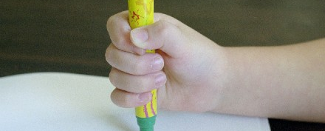
Fisted Grasp
Toddler grasps marker with whole hand and “thumbs up” position.
Movements are generally from the shoulder.

Slide 38
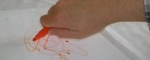
Palmar Grasp
Pencil lies across the palm of the hand. Thumb is pointed down towards the paper and the elbow is out to the side.
Shoulder may be stronger and child uses a combination of shoulder and elbow movements.

Slide 39
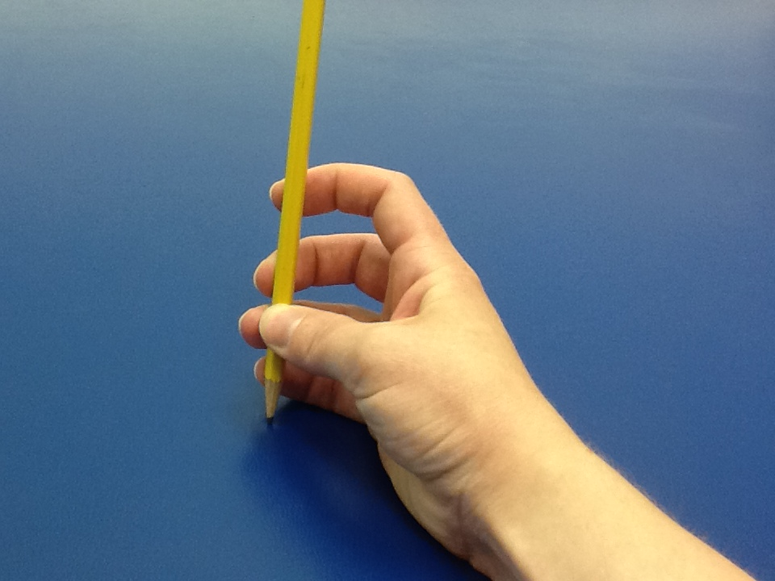
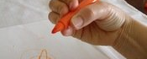
Five Finger Grasp
Can be typical for a 4 year old. Wrist may be above the writing surface and wrist movements are used for coloring.

Slide 40
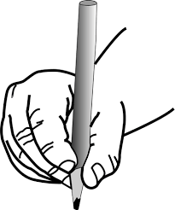
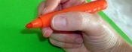
Tripod Pencil Grasp
Develops around age 5 or 6 and sometimes later. Initially fingers are held stiffly and child may use wrist movements. Finger movements are noted as finger muscles become more skilled.

Slide 41
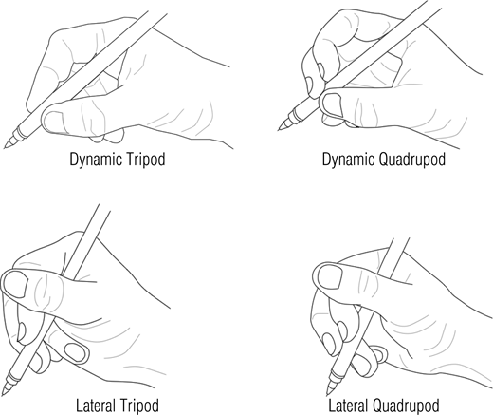
Additional Prehension Patterns

Slide 42
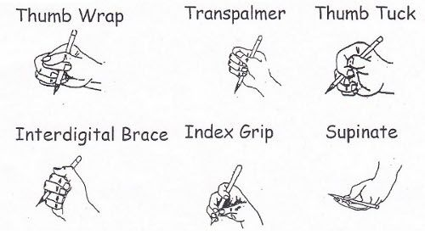
Alternative Prehension Patterns

Slide 43
Questions ???

Slide 44
Handwriting and Keyboarding Strategies for the Classroom
Dr. Kim Hartranft otd, otr-L
khartranft@wsdweb.org
2/12/16

Slide 45
Basic Skills for Handwriting
Fine Motor Skills
Posture
Strength
Prehension patterns
Visual Motor Skills
child’s ability to copy shapes, letters or numbers.
Vision guides written output
Visual Perceptual Skills
Child uses visual information to make meaning of what he sees.
When learning a letter, a child must be able to recognize it, recall it, and discriminate between similar shaped letters such as “p and b.”

