Slide 1
Review of Occupational and Physical Therapy in the Classroom
Kim Hartranft OTR/L
Kerri Braun, MOTR/L
Carol Mulligan, PT

Slide 2
IDEA is pushing more towards an “Integrated Model” for delivery of service
The entire team participate in developing the students goals
Experts indicate that goals and objectives belong to the student and all team members are responsible for contributing information and skills for maximum success of that student

Slide 3
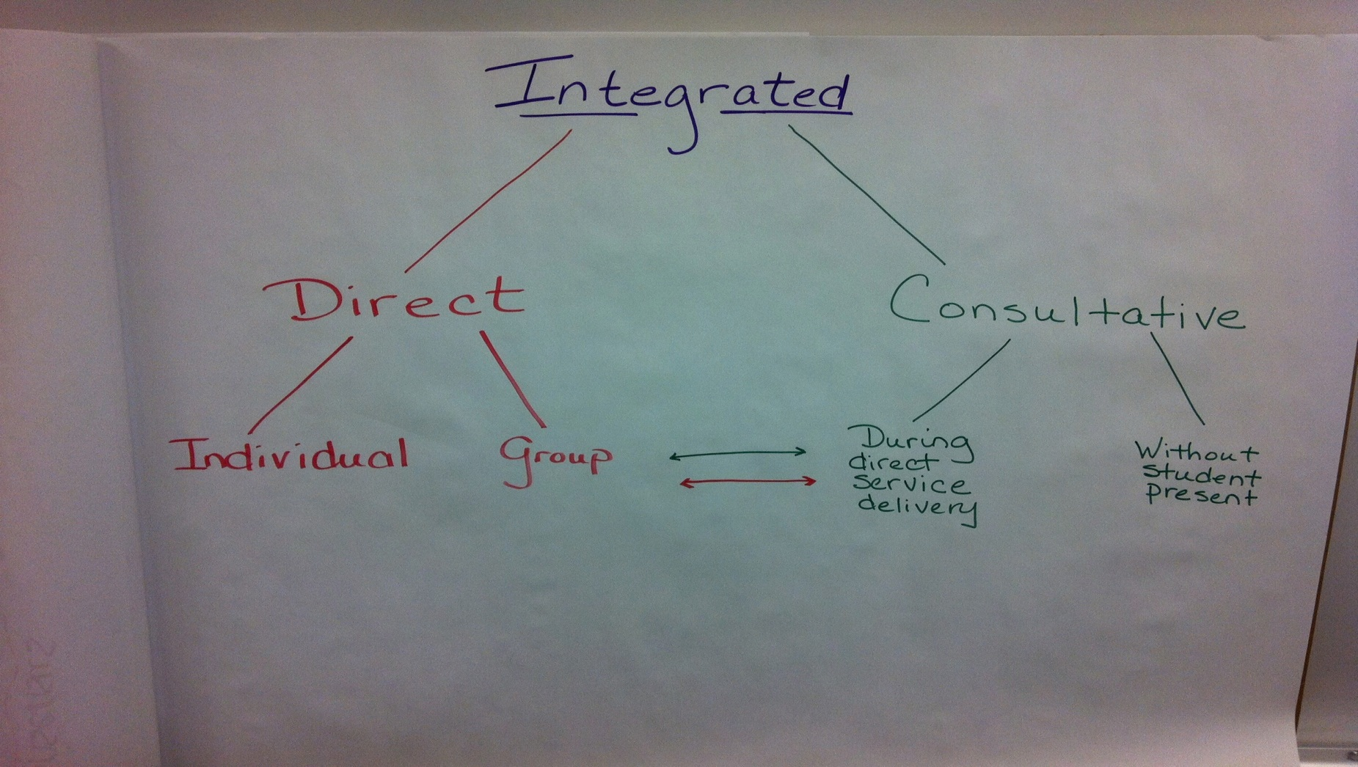
Related Services (PT, OT, and Speech)

Slide 4
Service Frequency
You may see frequency written like
30 sessions per IEP year; 30 minutes each; integrated
In the present ed levels there should be a statement explaining what this may look like such as “ ______ continues to be eligible for OT, PT and/or Speech. Services are delivered in an integrated model with consists of services in the natural learning environment through small group, individual and consultative support.”

Slide 5
Breakdown of services
Based on a 6 day cycle:
25 sessions per IEP year = 1 session per week
35 sessions per IEP year = 1 ½ sessions per week
50 sessions per IEP year = 2 sessions per week
Based on 5 day schedule: sessions are 30, 45, 60 per IEP year
Minutes should be stated as well
30 minutes
45 minutes
60 minutes
Stating it this way allows for more flexibility with beginning and end of school year, meetings, assemblies, holidays etc.

Slide 6
Where do we Deliver services?
Doesn’t necessarily have to be in a pull out model
Collaboration with other related service
Can be in the classroom
During a special activity or CBI trip
During encore or specials
During bathroom times
Wherever we are needed to assist a child to function in the school environment is where we can go.
Research is showing that taking a child out in isolation is not promoting efficient carryover skills; this is why we are trying to integrate more.

Slide 7
make up sessions for related service
IEP/SETT meeting occurs = can count for sessions for that week
Make- ups can occur within the IEP year
Can be in the classroom
During a special activity or CBI trip
Co-Treatment with other related services

Slide 8
QUESTIONS?????
Feel free to contact us anytime! No question is ever a silly question!
Carol PT – Cmulligan@wsdweb.org
Kerri MOTR/L – KBraun@wsdweb.org
Kim OTR/L – KHartranft@wsdweb.org

